Slide 1
APA Chapter 1
Scholarly Writing and Publishing Principles

Slide 2

What is the APA? Why do we need style guidelines?
APA == American Psychological Association
  Largest scientific/professional organization of psychologists in the US
Why do we need writing guidelines?
  Helps authors write in a clear, concise format
  Readers can quickly scan works for key points

Slide 3
Writing as a Scientist
Research
  Not complete until findings are shared
Findings are usually shared via publication in scientific journals
Journal articles serve as repositories of our collected knowledge

Slide 4
How do Scientific Writings get Published?
Accepted! ☺
Submit to journal
Peer Review
Decision
Revision
Rejected ☹

Slide 5
Writing as a Student
Students are also members of the scholarly community
  Student writing promotes critical thinking, self-reflection, etc.
Learning APA style benefits students by providing a framework for organizing ideas
Student research:
  Finding relevant articles
  Formatting thesis/class projects
  Grad school in psychology

Slide 6
Quantitative and Qualitative Articles
Traditional “Research” articles
Primary sources that report an original contribution to the literature
Differ in the type of data/research design they report

Slide 7
Quantitative Articles
Typically report experimental, quasi-experimental, and correlational studies
Quantitative Research == observed outcomes are numerically measured
  Example: Factors that affect life-satisfaction scores, memory studies looking a proportion of correctly recalled items, etc.

Slide 8
Qualitative Articles
Case Studies, Social Interactions, Text Analysis
Qualitative == generate knowledge about the human experience and/or social interactions
Still research, just not numerical!

Slide 9
Case Studies
Reflect a special type of qualitative design
Report observations/interactions with a Single Individual, Group, or Community
Illustrate a problem in depth, shed light on needed research, etc.
Common in Clinical or Applied fields of psychology

Slide 10
Literature Reviews
Summarize and evaluate findings or theories within a literature
  Example: Review of treatment methods for depression, historical overview of memory research, etc.
Can summarize both quantitative and qualitative research findings

Slide 11
Meta-Analyses
Refers to a collection of techniques for drawing conclusions from many published studies on a topic
  Synthesis of the literature
Can be quantitative or qualitative, depending on the studies examined
  Data are analyzed/reviewed at the study level, not the participant level
Questions answered:
  Do many studies on the same topic reach similar conclusions?
  For quant: Does the effect size differ between studies?

Slide 12
Replication Articles (1)
Replication is an important issue in psychological research
Replication == can an established finding be found again, using a different sample, materials etc.?
Replication articles are becoming increasingly common
May also include an extension:
  Testing whether a previously reported finding replicates in new situations

Slide 13
Replication Articles (2)
The goal of replication articles is test whether findings from an earlier study stay the same/similar
  Different samples
  May vary materials used (extension studies)
Important part of the scientific process!
  If a study fails to replicate, was its effect real?

Slide 14
Ethical Standards for Authors (1)
Accurate reporting of research results
Published errors and retractions
Plagiarism

Slide 15
Ethical Standards for Authors (2)
Accurate reporting of research results
Published errors and retractions
Plagiarism

Slide 16
Plagiarism
APA defines plagiarism as “presenting words, ideas, or images of another as your own”
Doesn’t have to be deliberate
Why is it an issue?
  Disrespects the efforts of the original authors
  Future research: Harder to trace back an idea to its original source
  Unfair to those who originally completed a work
Easy to avoid: Just cite your work!

Slide 17
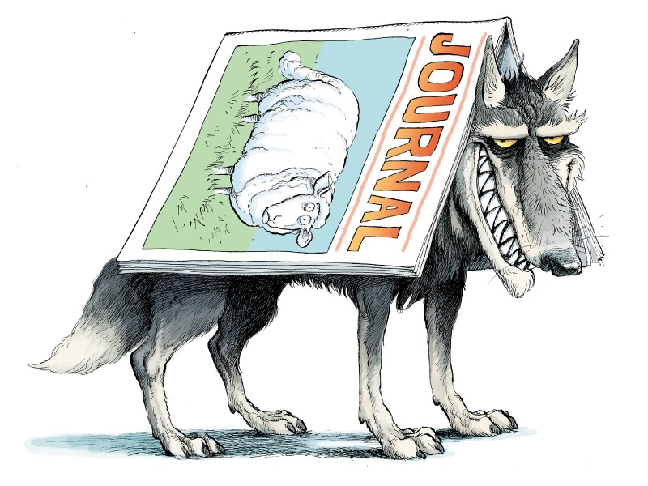
Consider the Source! (1)
Always check where a publication is coming from
  Is it published in a reputable, peer reviewed journal?
Watch out for predatory journals (yes that’s a thing!)
  Accept articles for publication for a price
  Don’t check for quality, ethical compliances, plagiarism, etc.
  Why is this a problem?
    Will publish ANYTHING for the right price
  https://beallslist.net/

Slide 18

Consider the Source (2)
Conflicts of Interest:
  Do personal interests affect the conclusions researchers draw?
    Does the author have a financial interest to publish certain findings? (extreme case)
  If yes, increases the likelihood of bias (i.e., they have an incentive to publish these findings)
    Undermines the credibility

Slide 19
Reminder!
Be thinking about your paper topics!
  Topic proposal due on 9/12!
Topic list will be posted on D2L – go look at it!
  Pick two or come up w/ your own topics.

